Slide 1



Learning-Based Extraction of First-Order Logic Representations of API Directives
Mingwei Liu¹, Xin Peng¹, Andrian Marcus², Christoph Treude³,
Xuefang Bai¹, Gang Lyu¹, JiaZhan Xie¹, Xiaoxin Zhang¹
¹Fudan University , China
²The University of Texas at Dallas, USA
³The University of Adelaide, Australia
Notes:
Hi, every one. I’m Mingwei Liu from Fudan University in China. Today, I will present our work: “Learning-Based Extraction of First-Order Logic Representations of API Directives”.

Slide 2
/01
Motivation
Notes:
First, we present the motivation of our work.

Slide 3
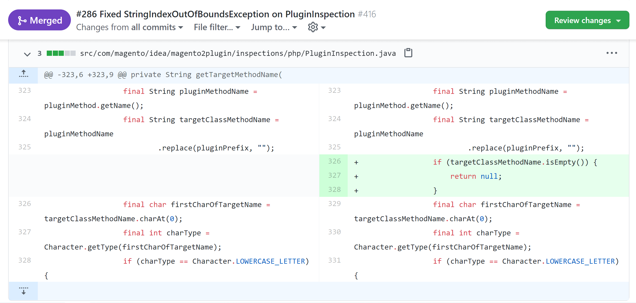
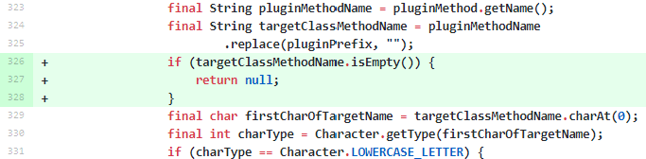

Motivation
API Directive for java.lang.String.ChatAt(int) from API Documentation
Developers often overlook directives in API documentation, which may lead to defects or improper implementations
Notes:
The slide shows a GitHub pull request about fixing a bug. In fact, this bug is very simple. The bugy code directly calls the ChatAt method of String class with index parameter as 0. When the length of the string is zero, the old code will throw an exception. This bug could be fixed by adding a guard condition to check the length of the string, which is the code in green. Actually, such API directive knowledge exist in the API documentation. However, Developers often overlook them, which may lead to defects or improper implementations

Slide 4


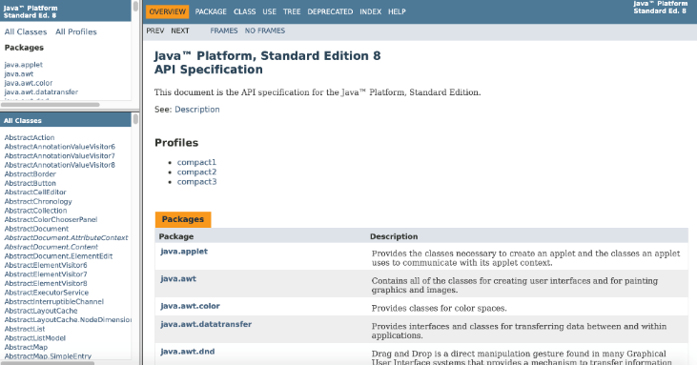

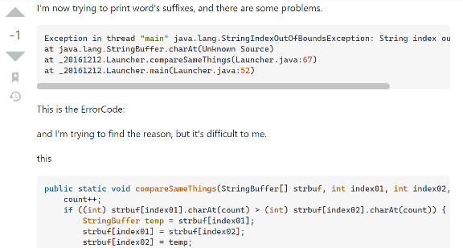
Motivation
API Reference Documentation
API Directive Knowledge
Information Overload
Scattered Knowledge
Unstructured and Ambiguous Expression
Stack Overflow
Although well-maintained API documentation exists, it is often not easy for developers to effectively access relevant knowledge on how to use an API.
Notes:
Although well-maintained API documentation exists, it is often not easy for developers to effectively access relevant knowledge on how to use an API, often do not have the patience to read the API documentation, they would rather directly ask questions on SO. The knowledge of API directives is buried in the documentation. Because API documentation is often overloaded with information. Related knowledge is scattered in different places with Unstructured and Ambiguous Expressions.

Slide 5

Motivation
API Directive for java.lang.String.ChatAt(int) from API Documentation
identify API directives and transform them into FOL formulas
(LessThan(index, 0) ∨ GreaterOrEqual(index, String.length())) → Throw(String.ChatAt(int),IndexOutOfBoundsException)
The extracted FOL directives are more structured, no ambiguity, and easy to understand. They could be recommended to developers in an on-demand way or a push way for the APIs used in code
FOL is machine-processable form and could be used to support automated tasks such as, the detection of API misuses and documentation defects
Notes:
In order to improve the accessibility of the API directives, Our idea is to extract First-Order Logic Representations of API Directives from API documentation. The slide shows an example for the FOL we will extract for the API directive. The extracted FOL directives are more structured, no ambiguity, and easy to understand. They could be recommended to developers in an on-demand way or a push way for the APIs used in code. FOL is machine-processable form and could be used to support automated tasks such as, the detection of API misuses and documentation defects

Slide 6
Challenges
01
Complex Logical Structures
First, an API directive may involve complex logical structures consisting of multiple clauses.
For example, the return value directive for javax.swing.UIDefaults. getIcon(Object) is “if the value for key is an Icon, return the Icon object; otherwise return null”.
02
Various Predicates Expressions
The predicate of a clause can be expressed in many different ways. For example, instead of stating that a parameter is non-negative, a directive may state that passing a negative parameter is not allowed.
03
Various Argument References
Third, the arguments of a clause may involve API elements that are mentioned with different kinds of pronouns or aliases. For example, a parameter named “obj” may be mentioned as “the second parameter” or “the object”.
Notes:
However, there are some chanllenges in extracting such structured representation of API directives. First, is the complex logical structures. Directive sentence may include multiple clasue with ``if, else, otherwise’’. Second is the varous predicates expression, the same API directive could be described in different ways. The third is various argument references. For example, a parameter named “obj” may be mentioned as “the second parameter” or “the object”.

Slide 7
/02
Approach
Notes:
不需要说

Slide 8
Key Steps of LeadFOL
LeadFOL (Learning based Extraction of API Directives in FOL)
Formula Normalization
Group the formulas of the same API class/ interface or method together and transform them into conjunctive normal form
Argument Parsing
Parse the arguments in the extracted atomic formulas to recognize the involved constants, expressions, and API elements
Logical Relation Recognition
Atomic Formula Extraction
Recognize the logical relations between the extracted atomic formulas by parsing sentence structure
Directive Sentence Identification
Extract atomic formulas from each directive sentence by recognizing the predicates and arguments
Identify directive sentences from API documentation using classifier
Input: API library and its documentation
Output: FOL directives for API classes/interfaces and methods
Notes:
To solve these challenges, we propose an approach to extract FOL directives from API documentation. The approach is named LeadFol. Which is short for Learning based Extraction of API Directives in FOL.
The Input is API library and its documentation
Output is FOL directives for API classes/interfaces and methods
The method include five steps, directive sentence identification. Atomic Formula extraction, logical relation recoginition, argument parsing, formula.
Next we introduce each step in detail with some examples.

Slide 9
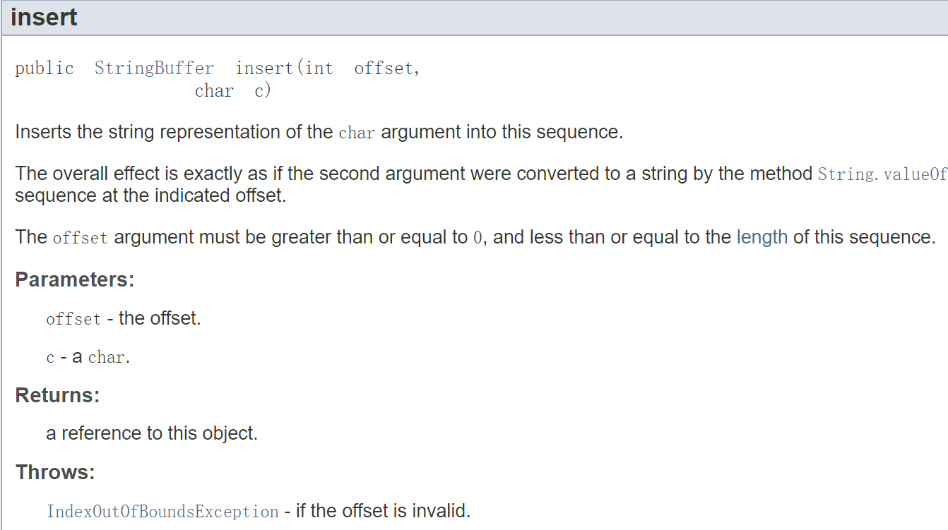
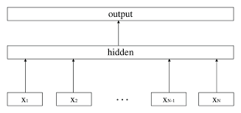
Directive Sentence Identification
API Reference Documentation
Sentence1: Inserts the string representation of the char argument into this sequence.
…
Sentence4:The offset argument must be greater than or equal to 0, and less than or equal to the length of this sequence.
…
StringBuffer.insert(int, char)
Directive Sentence 1:The offset argument must be greater than or equal to 0, and less than or equal to the length of this sequence.
…
FastText
Directive Sentence Classifier
Notes:
THE first stpe is directive sentence identification. We first extract some API description sentences from API documentation. For each sentence, we use a directive sentence classfier based on FastText to predict whether it is a directive sentence. The sentence in green is the directive sentence identified. It describes the range limitation of the offset argument.

Slide 10
Atomic Formula Extraction
Directive Sentence 1:The offset argument must be greater than or equal to 0, and less than or equal to the length of this sequence.
Pipeline with Two Subtasks
Joint Recognition based on New Tagging Schema
Arguments Recognition:
the offset argument; 2. 0;
3. the length of this sequence
Predicates Recognition:
1. GreaterOrEqual: the offset argument, 0
2. LessOrEqual: the length of this sequence
Arguments And Predicate Recognition:
GreaterOrEqual-1: the offset argument;
GreaterOrEqual-2: 0;
LessOrEqual-2: the length of this sequence
single model to reduce error propagation
two models with error propagation
GreaterOrEqual(the offset argument,0)
LessOrEqual(The offset argument, the length of this sequence)
Notes:
Next step is the most important part of our approach, we will extract the atomic formulas from directive sentence. One atomic formula only contains one predicate and one or more arguments. Multiple atomic formulas can form complex formulas. Because there are many ways to express predicates, which is difficult to be covered by some simple rules, so we decided to use a learning-based method to extract atomic formulas. From the example sentence, we want to extract two atoimic formulas, related to the lower bounds and upper bounds of the offset parameter respectively. ,which shown at the bottom of the slides. One way is to treat it as two subtasks arguments recognition and predicates recognition, and use a pipeline approach with two models. Argument recognition is to recognize the argument and oredicate recognition is to recoignize the predicate relations between arguments. Using two models could result in error propagation. We propose to use a joint Recognition based on New Tagging Schema we desined. We will recognize the argument with the predicate type, argument position at the same time. For example, we will recognize the length of this sequence as the entity with type LessOrEqual-2. In this way, we could use a single model to reduce the error propogation.

Slide 11
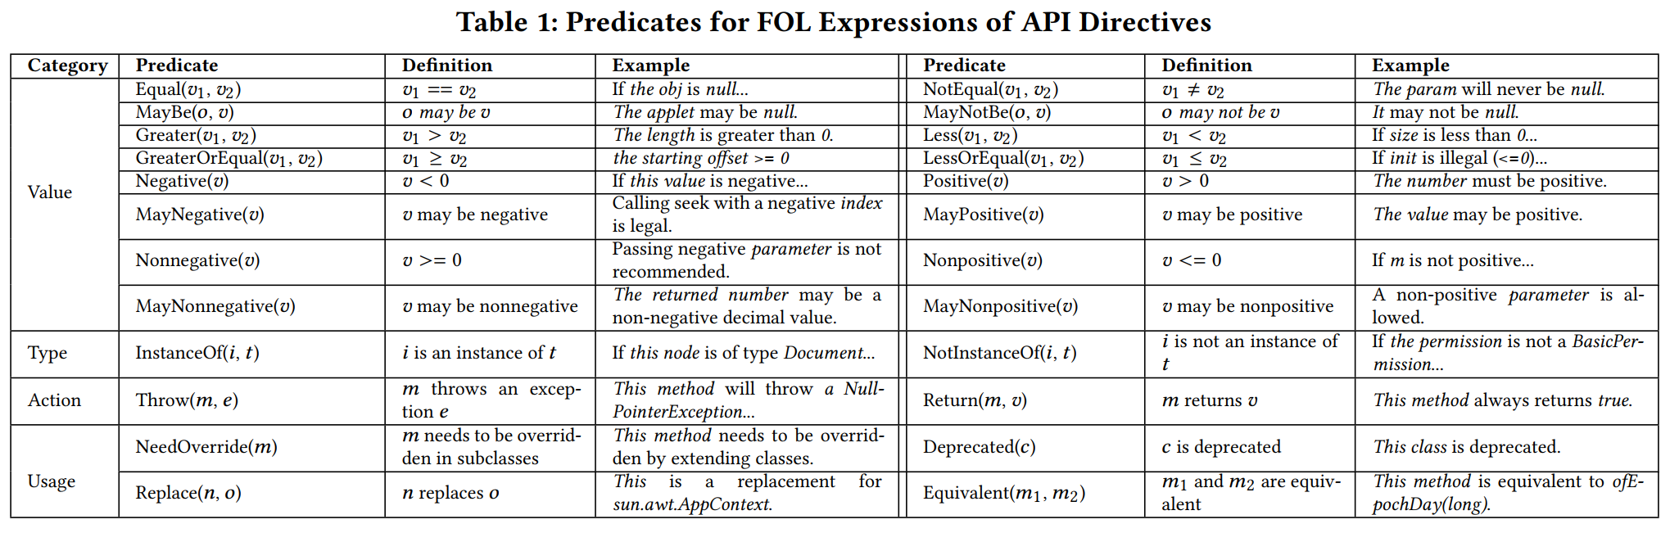
Tagging Schema
We studied 729 directive sentences sampled JDK reference documentation and identified 24 predicates that can be used in atomic formulas of API directives.
46 types of name entities for 24 predicates, e.g., Equal-1, Equal-2
Notes:
To use the learning-based approach, we studied some directive sentences sampled JDK reference documentation and identified 24 predicates that can be used in atomic formulas. This table shows all 24 predicates identified and they could be classified into four categories, value , type, atcion, usage. We further create 46 types of name entities from 2r4 predicates and each one is corresponding to one argument of predicate, e.g., Equal-1, is for the first argument of the predicate equal.

Slide 12
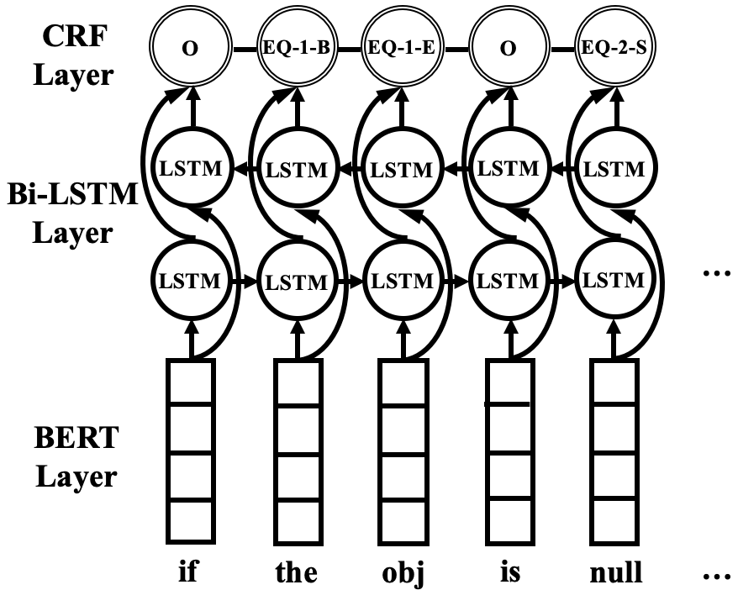
BERT-BiLSTM-CRF Model
IOBES: I (Inside), S(Single), O(Outside), B(Begin), E(End)
the obj: EQ-1
null: EQ-2
Equal(the obj, null)
BERT-BiLSTM-CRF
Notes:
Then we could use a deep leanring model to recogze the entities with type from sentence. The model is named BERT-BilSTM-CRF, it include three layers. It Accept a sentence as input and predicate tags for each words in the sentence as ouput. we could obtain the entiteis with type based on this model predication results. For the input if the obj is null, it could extract two entities with types, the obj and null, their types are EQ-1 and EQ-2. At last we could extract the atomic formula of equal based on the recognized arguments with types.
我们进一步分析各种statement类型，得到了一个高层的statements图，例如Functionality Specification contains Action and one or more Objects.

Slide 13
Logical Relation Recognition
GreaterOrEqual(the offset argument,0) ∧ LessOrEqual(The offset argument, the length of this sequence)
GreaterOrEqual(the offset argument,0),
LessOrEqual(The offset argument, the length of this sequence)
Conditional Structure Parsing
The sentence can have a nested conditional structure using conjunctions like “if ”, “then”, and “otherwise”. Conditional structure parsing is done by linguistic pattern matching.
If the obj is null, this method throws NullPointerException. =>
the obj is null-> this method throws NullPointerException
Clause Parsing
We use Spacy to analyze sentence’s syntactic structure to parse a composite clause to simple clauses with conjunctions like “and”, “or”, and “not”. Each simple clause will further be parsed to corresponding atomic formula.
The offset argument must be greater than or equal to 0,
and less than or equal to the length of this sequence.=>C1 ∧ C2
Notes:
Then we identified the logical relation between the identified atomic formulas. For example, from the sentence, we could identify the relation between two atomic formula as “and”. It include two steps, conditioan structure parsing, clasuse parsing. The sentence can have a nested conditional structure using conjunctions like “if ”, “then”, and “otherwise”.SO Conditional structure parsing is done by linguistic pattern matching. For example, from the orange sentence example, we could identify the infer relations between of two clauses because it matches with a existing linguistic pattern about if clasue.
Then, We use Spacy to analyze sentence’s syntactic structure to parse a composite clause to simple clauses with conjunctions like “and”, “or”, and “not”. Each simple clause will further be parsed to corresponding atomic formula.

Slide 14
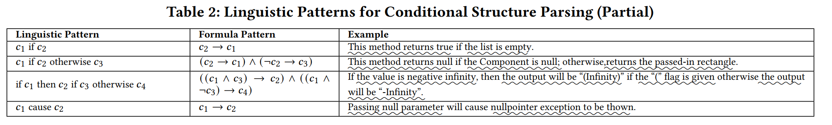
Linguistic Patterns for Conditional Structure Parsing
. We defined 51 linguistic patterns to recognize the logical relations by analyzing the directive sentences from API documentation.
Notes:
by analyzing the directive sentences from API documentation., We defined 51 linguistic patterns to recognize the logical relations This table show some lguistic pattern as examples. As we can seem some patterns involving “otherwise” are quite complex

Slide 15
Argument Parsing
GreaterOrEqual(the offset argument,0) ∧ LessOrEqual(The offset argument, the length of this sequence)
Selection of Candidate API Element
the offset argument
java.lang.StringBuffer.insert(int,chat).<P>offset
Candidate Filtering by Type
the length of this sequence
Learning based Candidate Ranking
java.lang.StringBuffer.length()
SVM model based on features, e.g., name similarity, context similarity
GreaterOrEqual(<P>offset,0) ∧
LessOrEqual(<P>offset, StringBuffer.length())
Notes:
Then , as we can see, the arguments in the formula are still vague. So We futher parse the arguments in the extracted formulas by resolving them to some constants, or link them to some API elements. For arguments can be linked to API elements, first we will select the candidate API elements for the argument, then we filter the candidate by some argument type constraints. After then we user a learning-based approach to rank all candidate and select the top1 as the linking API elements. We use a SVM model for this, which based on some features, such as name similarity, context similarity. At last the the offset argument is linked to the first parameter of the insert method , the leghth of this sequence is linked to the length() method of string class.

Slide 16
/03
Evaluation
Notes:
不需要说

Slide 17

Research Questions
RQ1: Quality of Key Steps
RQ2: Accuracy of FOL Directive Extraction
RQ3: Generalization of LeadFOL
RQ4: Usefulness for Supporting Code Reviews
Details are included in our paper.
https://liumingwei94.github.io/
Notes:
To evaluate our approach we conduct some experiments., We focus on following four Rearch question.
The detail is shown in our paper.
RQ1: What is the intrinsic quality of the key steps of LeadFOL? RQ2: How does LeadFOL compare with state-of-the-art for FOL directives extraction? RQ3: How does LeadFOL generalize to non-JDK APIs? RQ4: How does LeadFOL support code reviews?
To understand what information developers are looking for when
comparing APIs and how we could design an approach to assist
developers by providing such comparisons automatically, we conducted
an empirical study to investigate whether and where the
API reference documentation contains information useful for answering
API comparison questions asked on SO. We answered the
following research questions:
为了理解为什么设计。

Slide 18
Conclusion
We identified 24 predicates that can be used in atomic formulas of API directives.
We propose a learning based approach for extracting first-order logic representations of API directives from documentation, which we call LeadFOL .
Notes:
1. extractive, we extract most relevant methods and sentences for API
2. on-demand, we accept a user textual query, which describe the programming task at hand.
3. query-specific, we will generate Different Summaries of the Same Class for Different Queries.
4. Our summary is generated based

Slide 19
THANKS
Notes:
thaT IS ALL ,THANK YOU.

